Slide 1

Minor PROJECT PRESENTATION ON Queuing models in OPDs/ availability of beds/ admission of patients. A hospital based solution is ideal which can be integrated with city wide module.
SCHOOL OF ENGINEERING AND TECHNOLOGY
DEPARTMENT OF COMPUTER SCIENCE AND ENGINEERING
Presented By:
ABHISEK PANDA – 22UG010159
DEBABRATA MISHRA - 22UG010273
DIPTESH NARENDRA - 22UG010357
Under the Guidance of
Dr. Gitanjali Mishra
Dr. Gitanjali Mishra
Dept. Of CSE,
GIET University , Gunupur

Slide 2
OUTLINES
S.NO. | CONTENTS | PAGE NO.
1 | PROBLEM STATEMENT | 03
2 | INTRODUCTION | 04
3 | TECHNOLOGIES USED | 06
4 | NECESSARY DIAGRAMS | 07 – 14
5 | FEATURES | 15
6 | CHALLENGES | 16
7 | LIMITATIONS | 17
8 | SCREENSHOTS | 18
9 | CONCLUSION | 19
10 | FUTURE ENHANCEMENT | 20
11 | REFERENCES | 21

Slide 3
Problem Statement Title | Queuing models in OPDs/ availability of beds/ admission of patients. A hospital based solution is ideal which can be integrated with city wide module
Description | Technological solution as per queuing models in OPDs/availability of beds/admission of patients would be one area. Study of dispensation of various types of medicines/consumables and Inventory management modules at hospital level are key areas requiring support. NIC has already developed some modules but their implementation in Delhi is yet to be started. A hospital based solution is ideal which can be integrated with city wide module may be required.

Slide 4
INTRODUCTION
Optimizing Hospital Workflow – Smart queuing models in OPDs, real-time bed availability tracking, and automated patient admissions to cut wait times and improve patient care.
City-Wide Integration – Our website management system that connects multiple hospitals, ensuring better resource allocation and emergency response.
Queue & Bed Management – Real-time queue updates, and automated bed allocation eliminate manual records. Hospitals can upload data online, and patients can check bed availability before visiting, ensuring saving time, and enabling immediate response in emergencies.
Real-Time Notifications & Alerts – Instant updates for doctors, patients, and staff on appointments, bed availability.
Data-Driven Decision Making – Live analytics dashboards & automated reports to monitor patient flow, bed occupancy, and hospital efficiency, making healthcare smarter.
🚀Our system transforms to smart hospital management, reducing wait times, optimizing resources, and creating a smarter, more connected healthcare network.

Slide 5

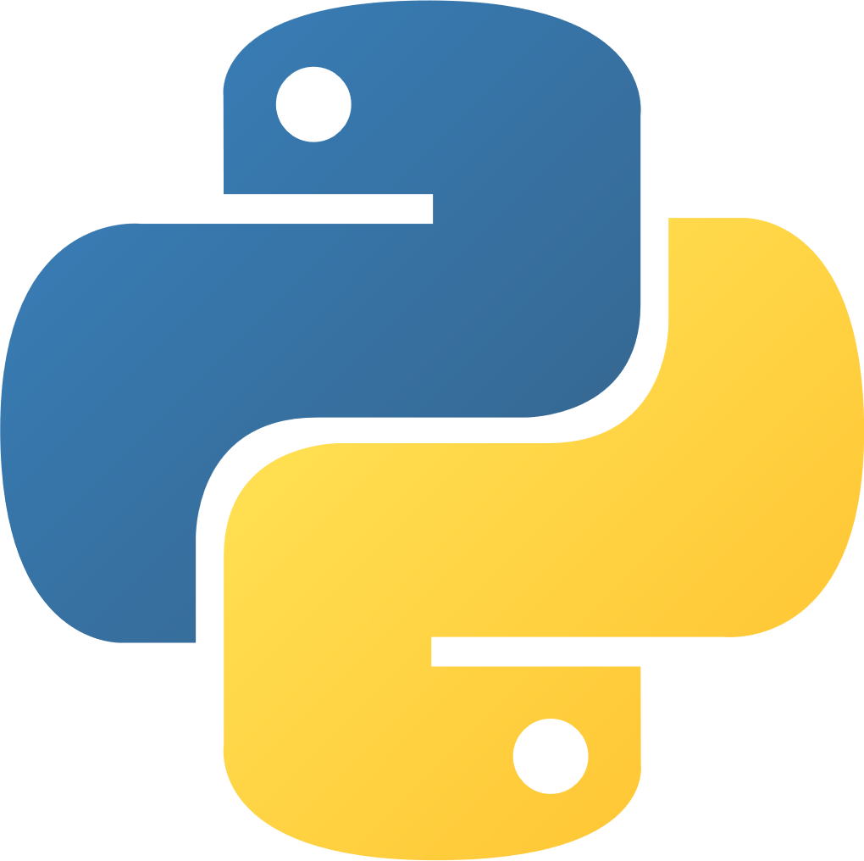



TECHNOLOGY STACK
HARDWARE REQUIREMENTS:
SOFTWARE REQUIREMENTS:
Server/Cloud Infrastructure – High-performance cloud servers for databases.
Hospital Workstations – Computers for doctors, admins, and staff to access the system.
Networking Devices – Routers & secure VPNs for seamless connectivity across hospitals.
Smartphones – For patients and doctors to receive real-time notifications.
Database Storage – Scalable storage solutions for patient records, queue management & bed tracking.
Backend – Python (Flask) for API development & MongoDB Atlas for database management.
Frontend – Html, CSS, Javascript for an interactive user interface.
🔐🛡️

Slide 6
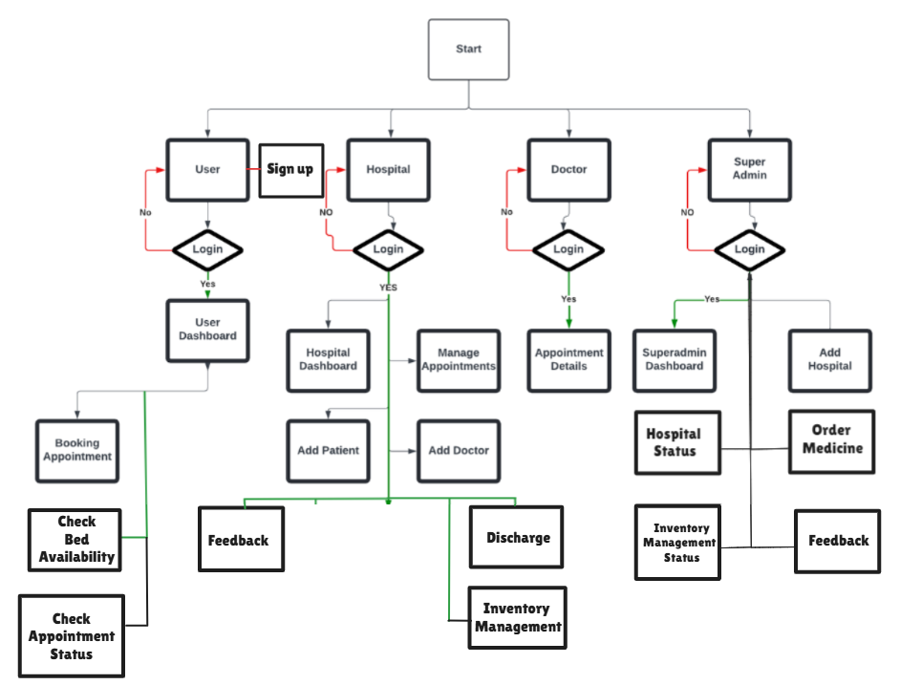
DIAGRAMS
FLOW CHART

Slide 7
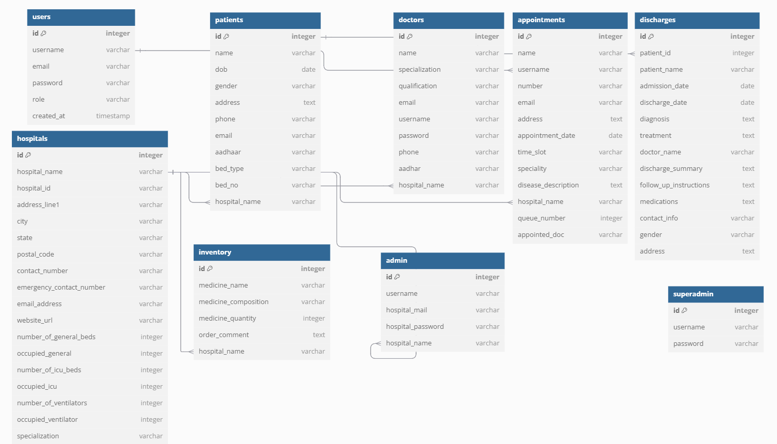
ER DIAGRAM

Slide 8
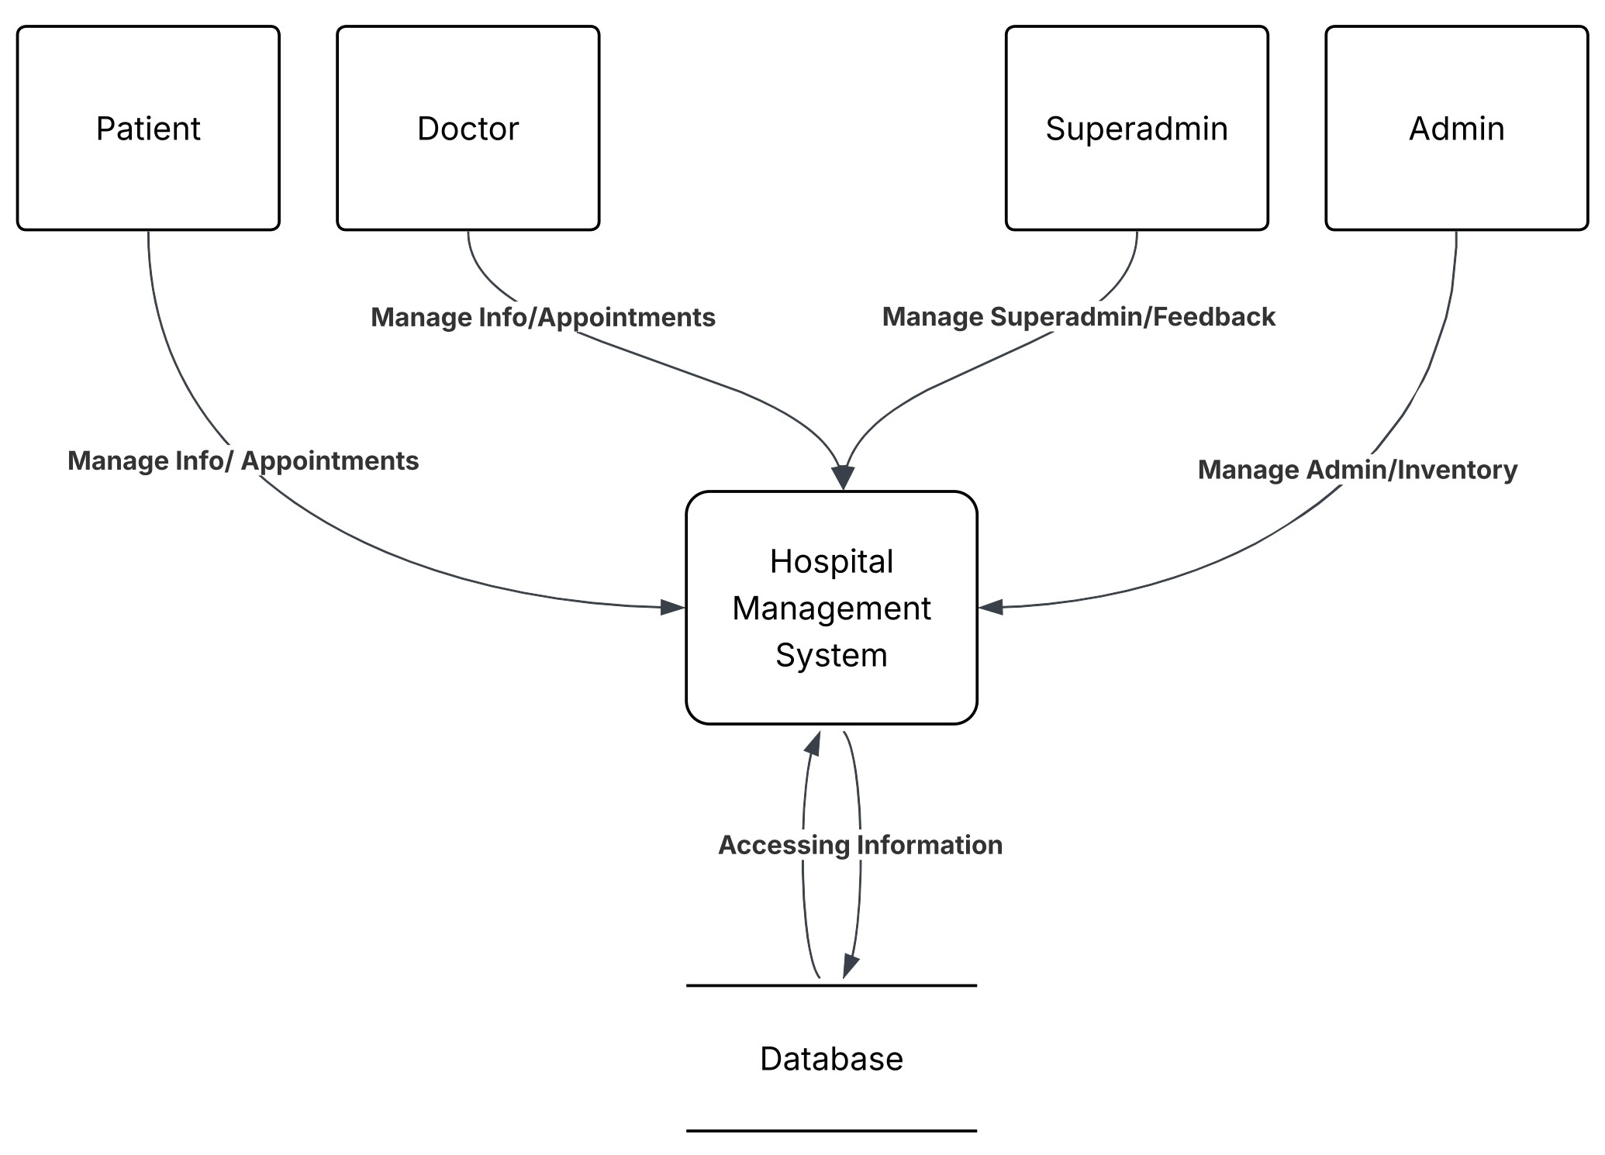
DFD Level-0

Slide 9
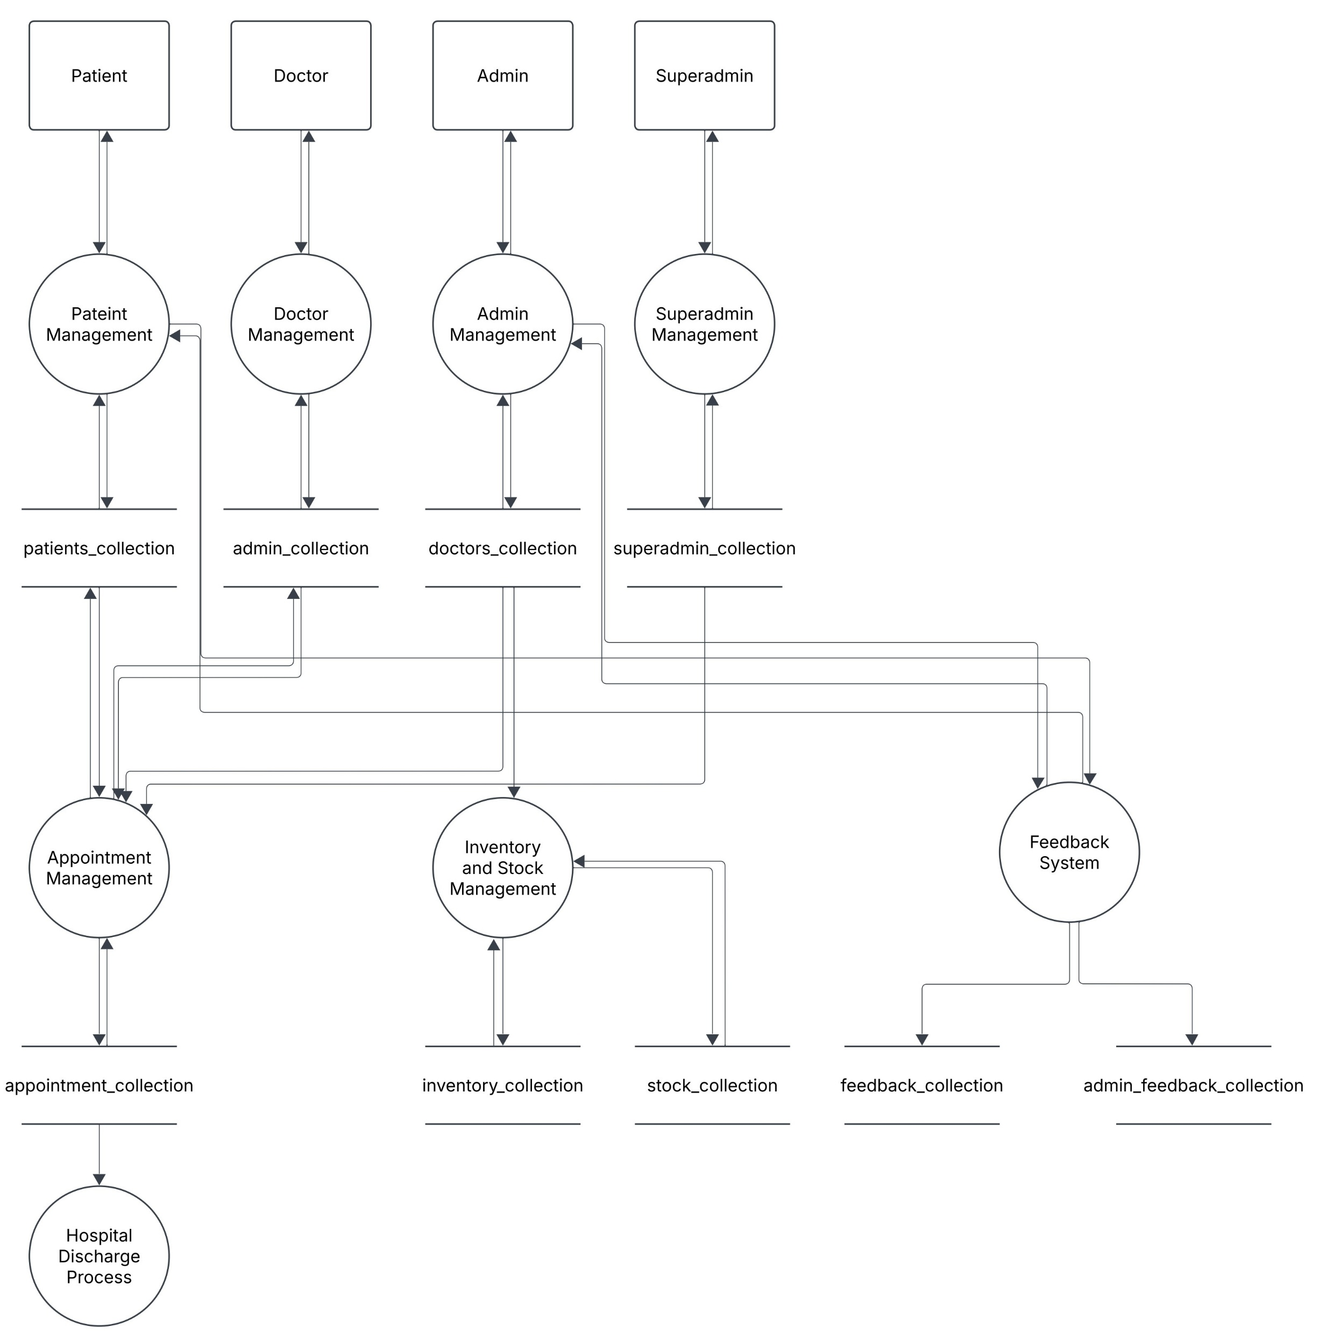
DFD Level-1

Slide 10
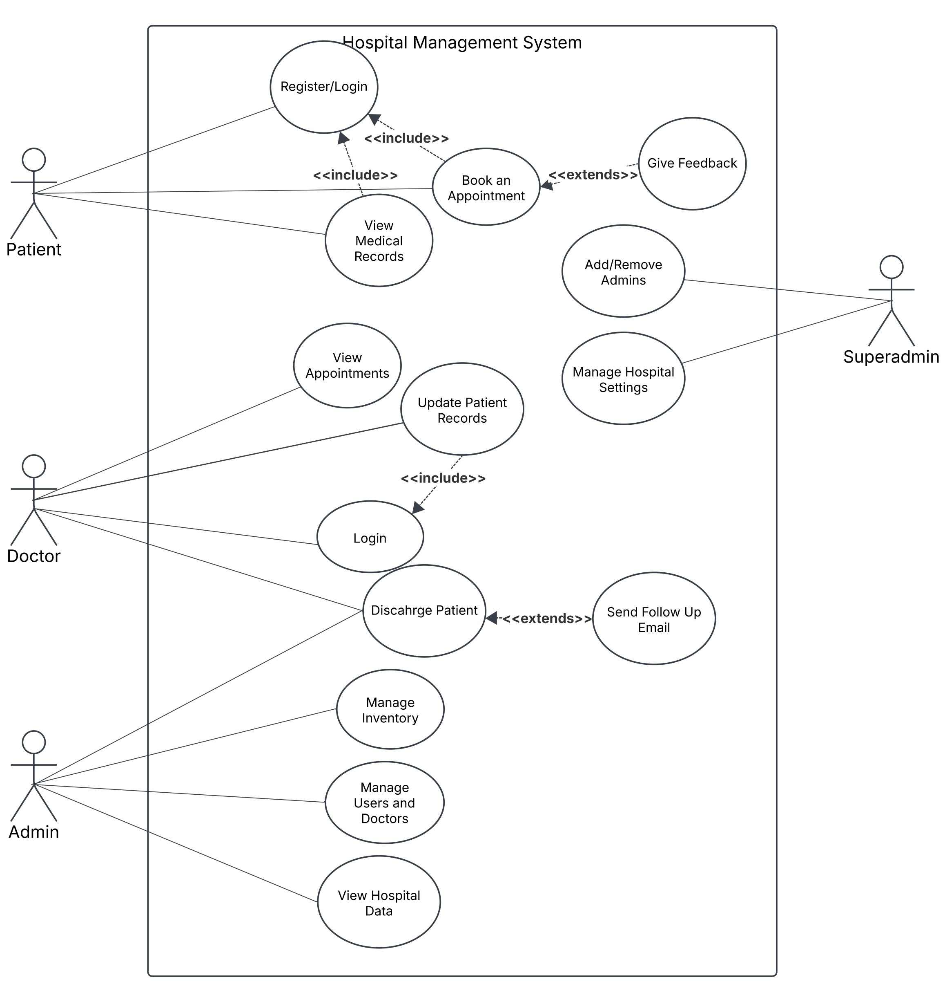
UML –Use Case

Slide 11
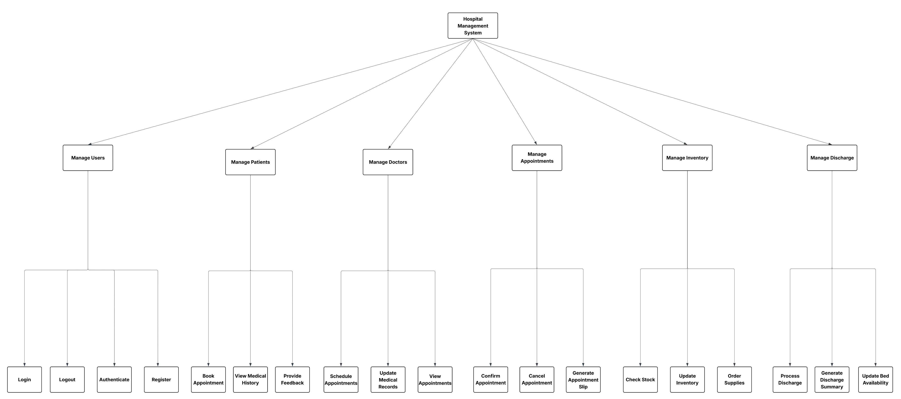
Structured Chart

Slide 12
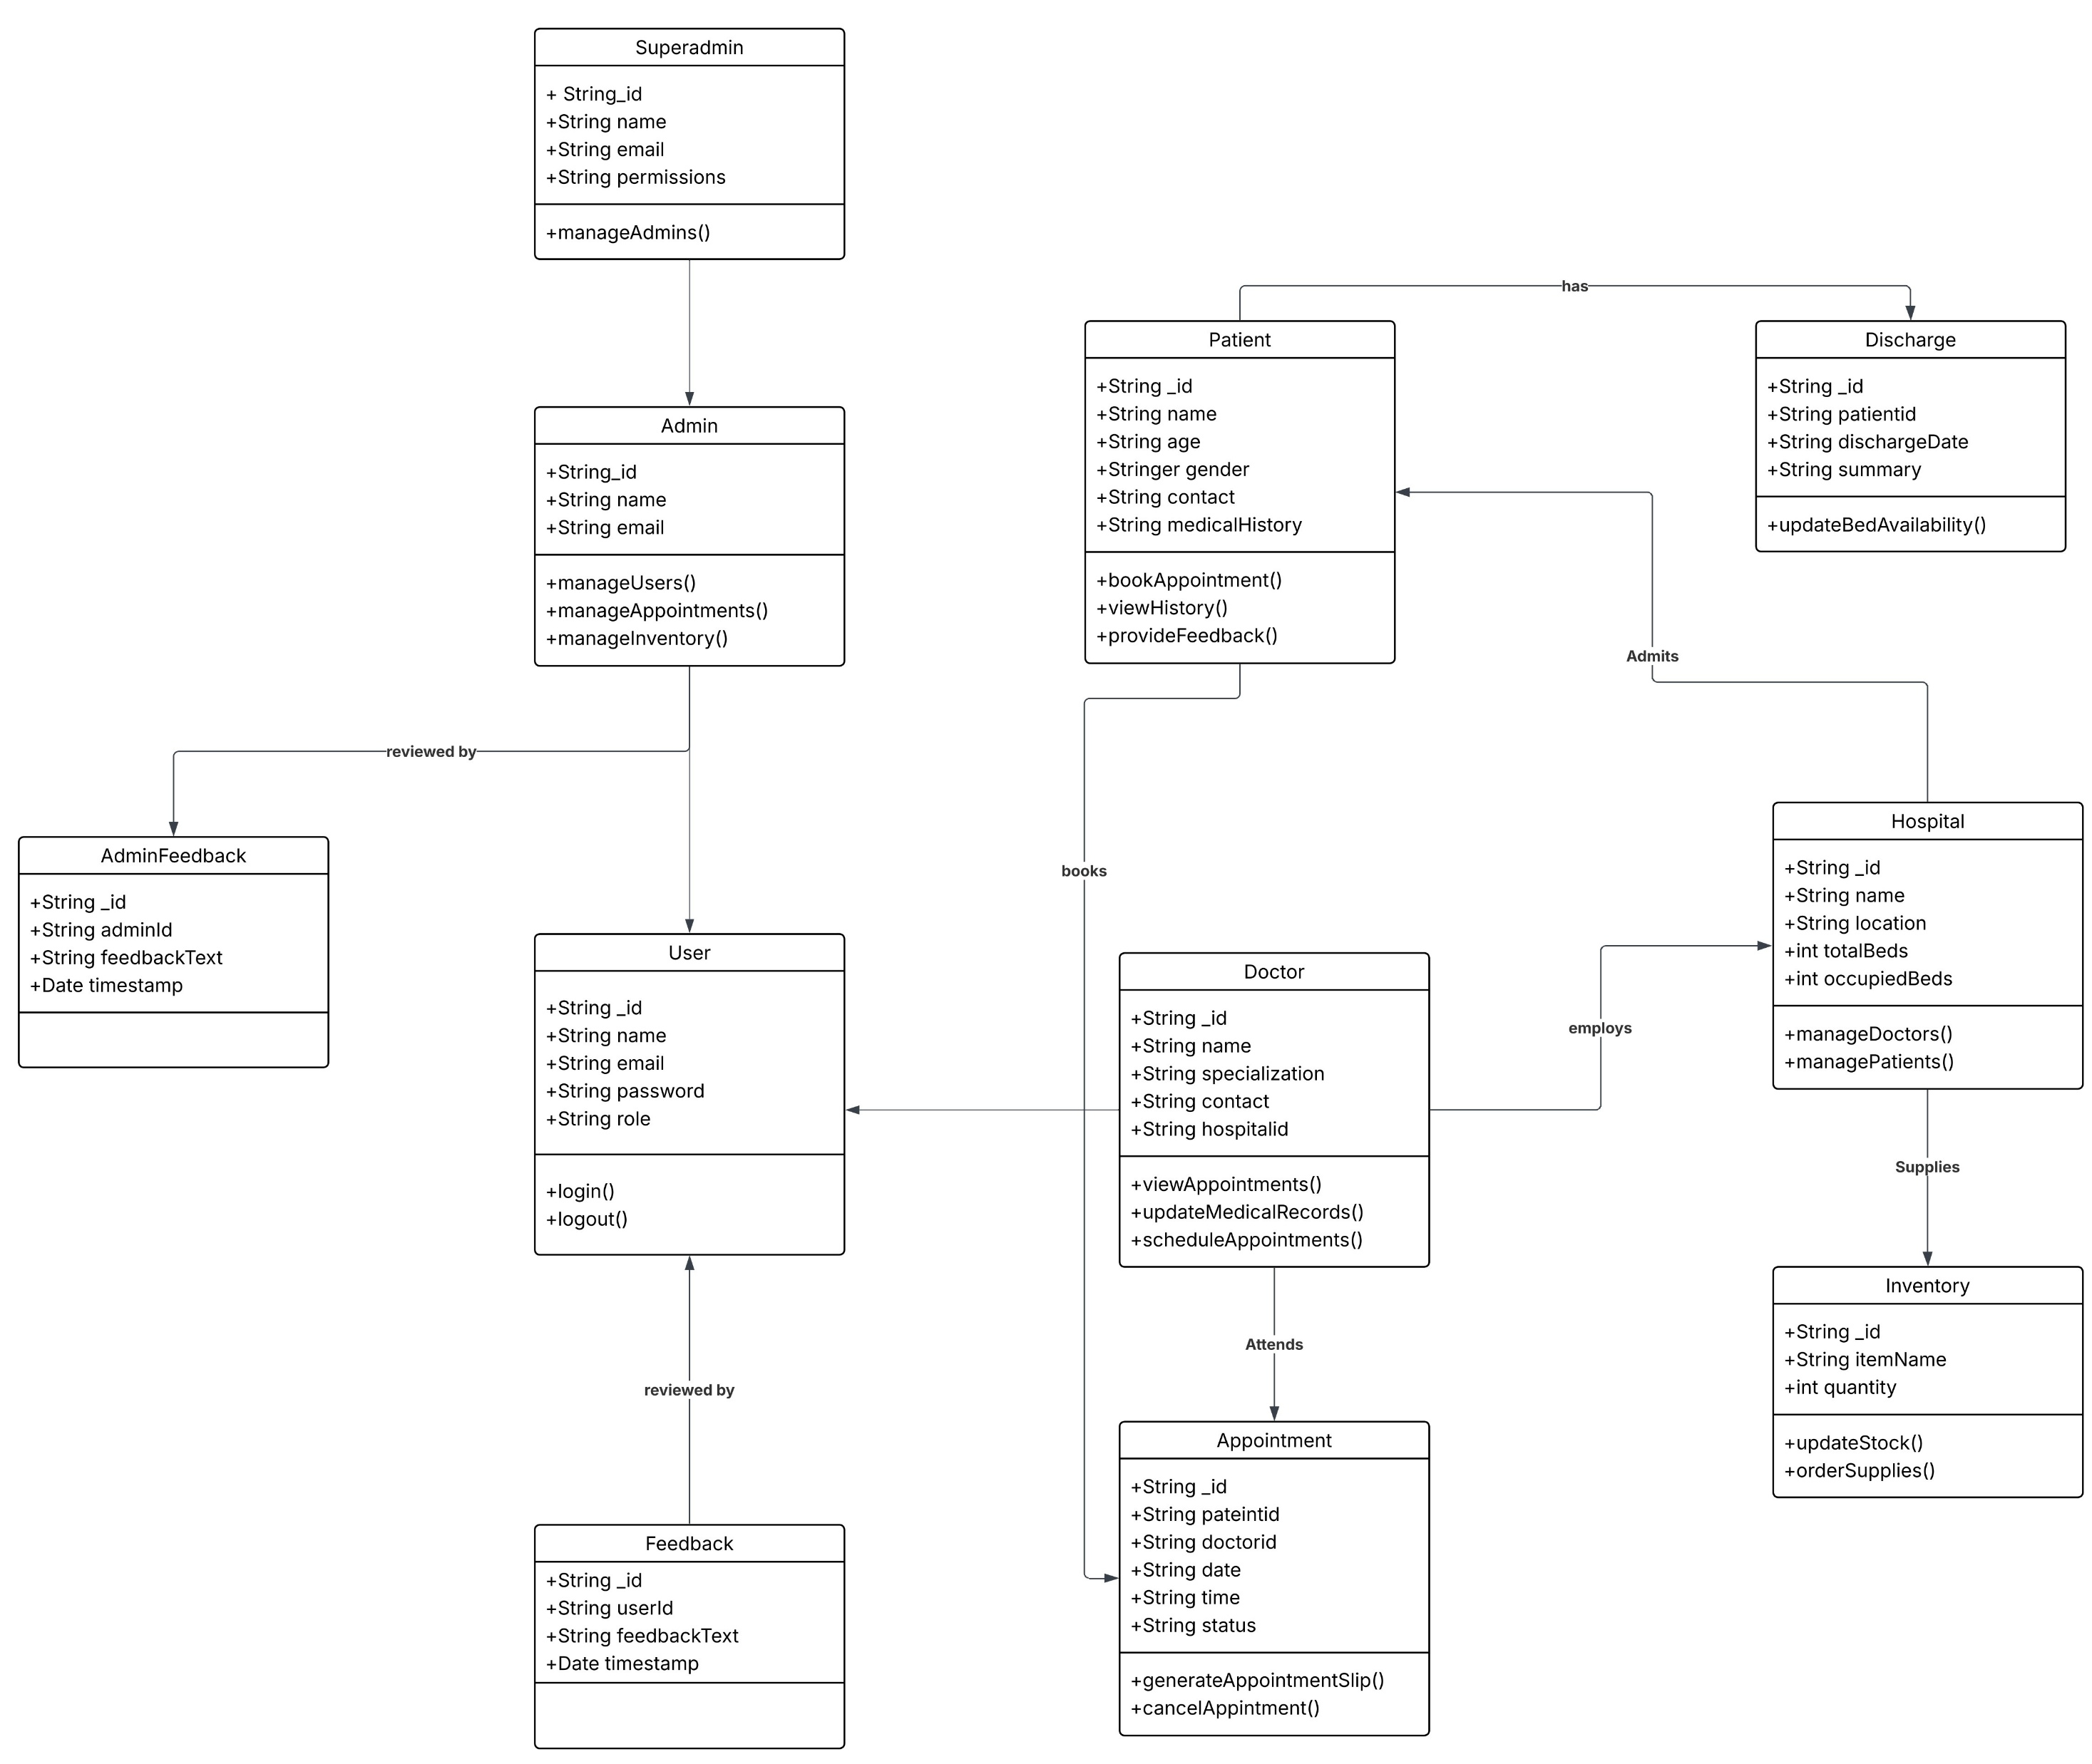
Class Diagram

Slide 13
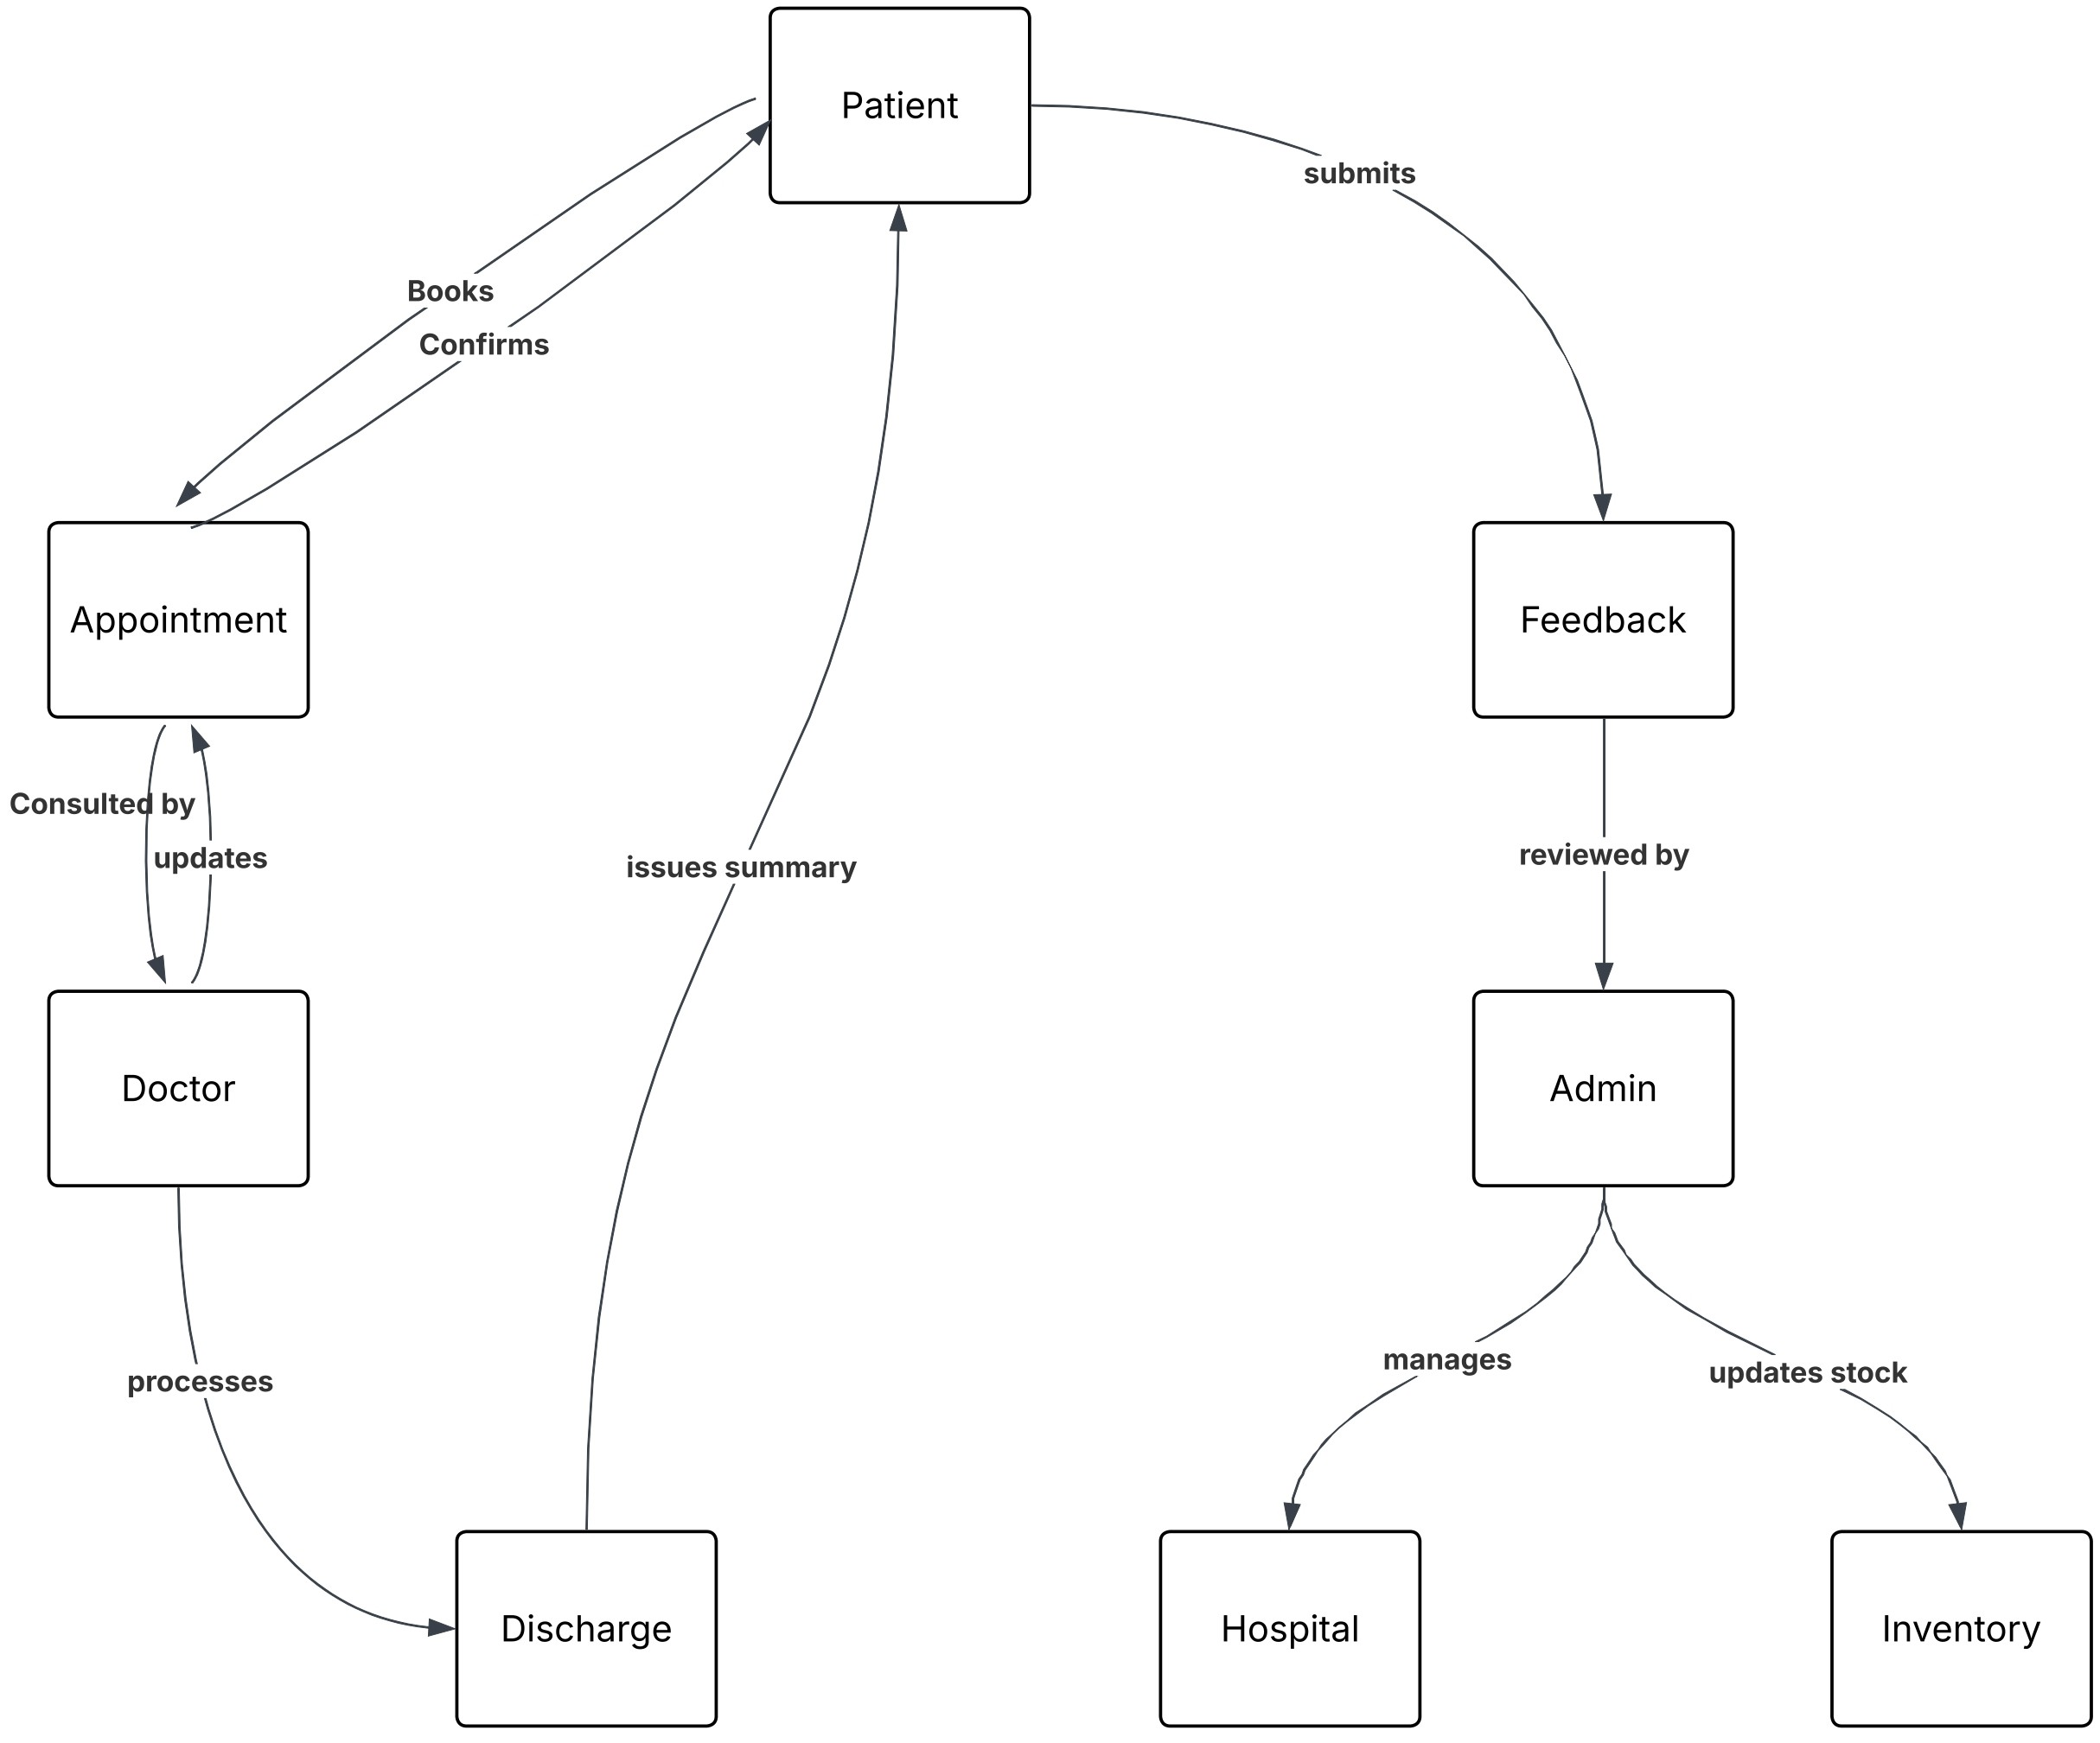
Collaboration Diagram

Slide 14
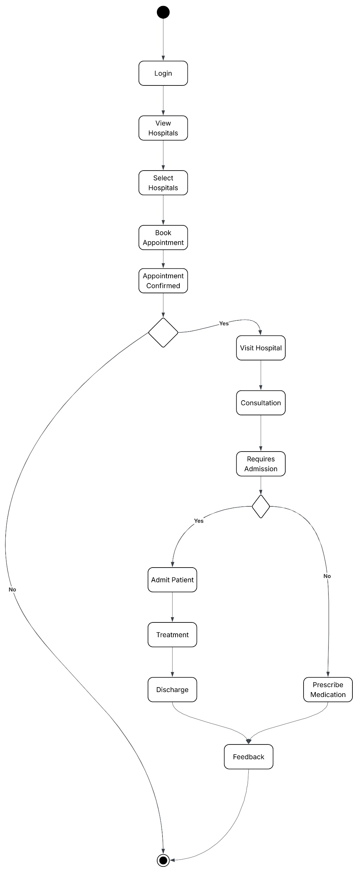
Activity Diagram

Slide 15
CHALLENGES
Scalability & Performance – Ensuring the system handles large hospital operations efficiently with optimized database performance.
Real-Time Data Synchronization – Managing live updates for bed availability, appointments, and inventory without lag.
Security & Role-Based Access Control – Protecting sensitive hospital and patient data with secure authentication and authorization measures.
Queue & Appointment Management – Developing a priority-based system for optimized patient flow and reduced waiting times.
System Integration & Future Enhancements – Ensuring seamless connectivity between different modules and planning for AI-driven improvements.

Slide 16
LIMITATIONS
Initial Setup Complexity – Requires significant time and resources for system installation, configuration, and data migration.
High Dependency on Internet Connectivity – Real-time updates and cloud-based functionalities depend on a stable internet connection.
User Training & Adaptation – Hospital staff and administrators need proper training to efficiently use the system.
Scalability Challenges – As hospital data grows, system performance must be continuously optimized to prevent slowdowns.
Data Security & Compliance Risks – Requires strict security measures to prevent data breaches and ensure compliance with healthcare regulations. 🚀

Slide 17
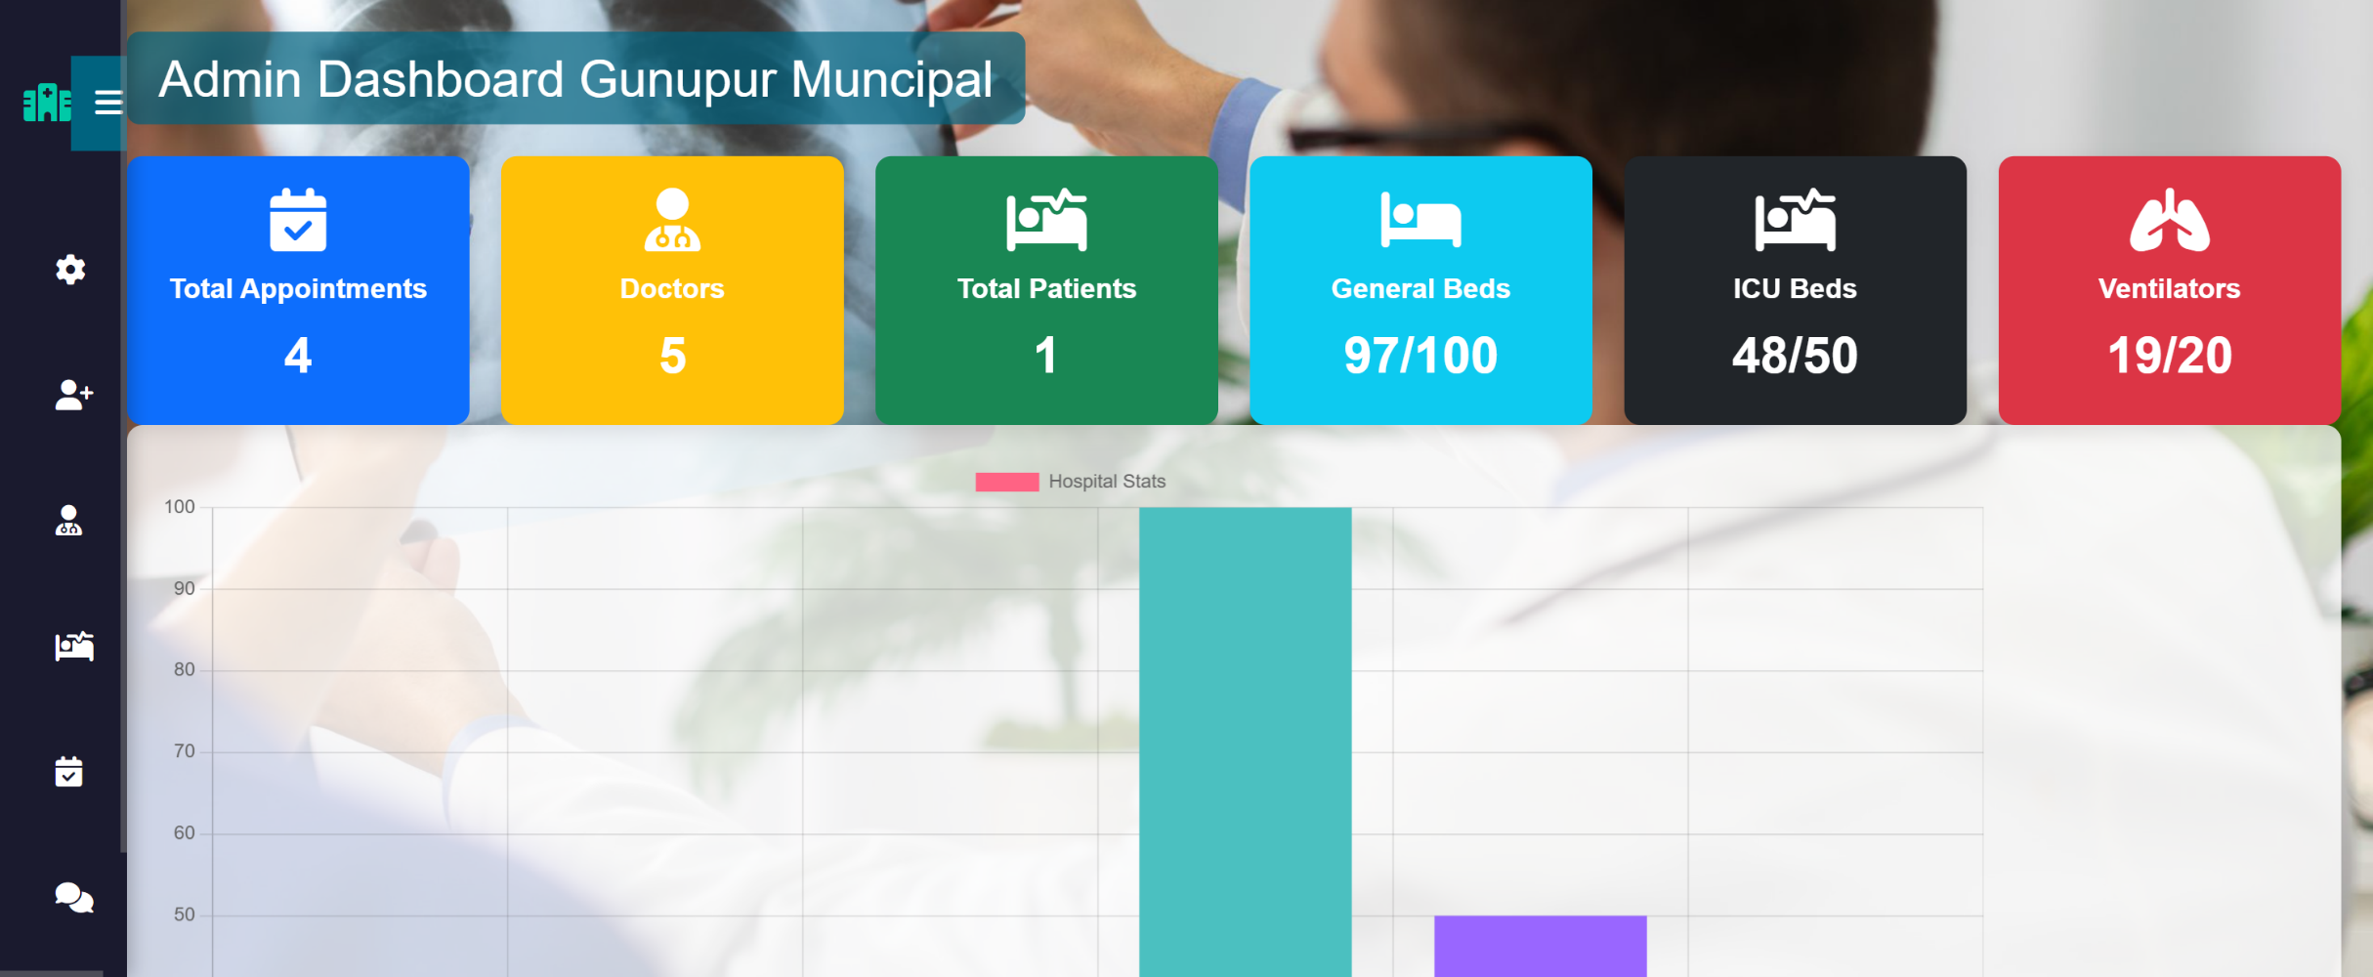
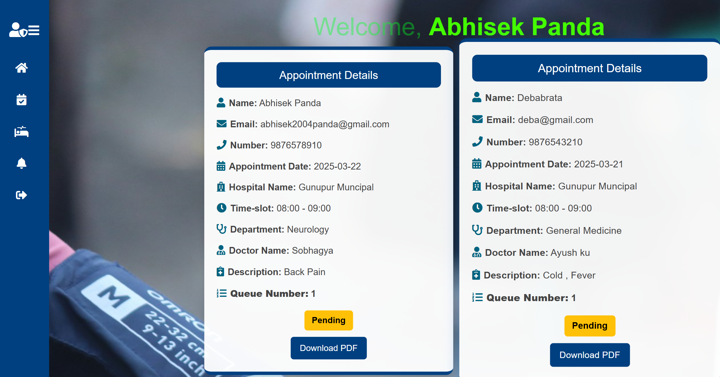
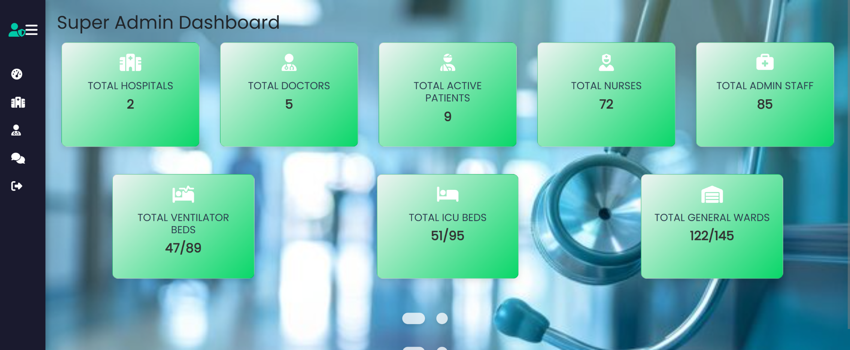
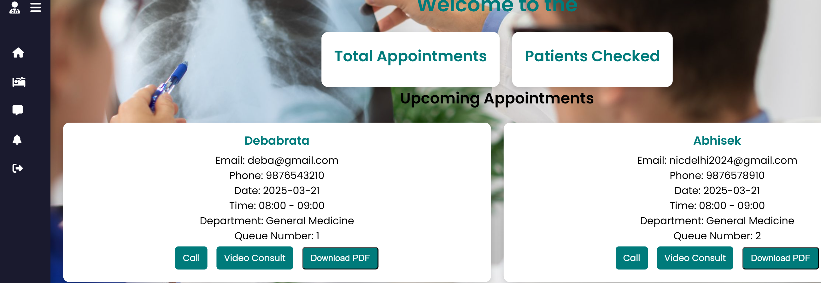
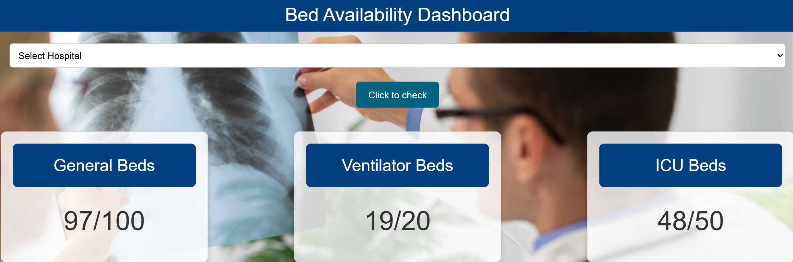
SCREENSHOTS

Slide 18
Conclusion
Efficient Hospital Management – The system streamlines hospital operations, improving patient care and resource management.
Enhanced Patient Experience – Provides a user-friendly interface for appointments, medical records, and feedback.
Real-Time Data Tracking – Enables live updates for bed availability, appointments, and inventory management.
Secure & Role-Based Access – Ensures data privacy with authentication, encryption, and controlled access.
Scalability & Future Growth – Designed to integrate AI, automation, and analytics for continuous improvements.

Slide 19
Future Enhancements
AI-Based Patient Diagnosis – Integrating AI for predictive analytics to assist doctors in diagnosing diseases more accurately.
Automated Queue Optimization – Enhancing the queue management system using AI to prioritize patients based on severity and real-time conditions.
IoT Integration for Real-Time Monitoring – Connecting medical devices to the system for live health tracking and automated alerts.
Multi-Hospital Interconnectivity – Expanding the system to integrate multiple hospitals for seamless patient transfers and city-wide healthcare coordination. 🚀

Slide 20
🔹 Programming & Frameworks:
HTML, CSS, JavaScript, TypeScript
Python (Flask), Node.js, Express.js
CSS
MongoDB Atlas for database management
🔹 Libraries & APIs:
Chart.js for data visualization
JWT (JSON Web Token) for authentication
Fetch API for asynchronous data handling
🔹 Development Tools & Platforms:
Visual Studio Code (VS Code)
GitHub for version control
🔹 Security & Authentication Resources:
OWASP guidelines for web security
MongoDB Security Best Practices
🔹 Online References & Documentation:
References
MDN Web Docs – Web technologies & JavaScript
Flask Documentation – Backend framework
Bootstrap Docs – UI framework
MongoDB Docs – Database management

Slide 21
Thank you all for your attention!

